Slide 1

Beyond Logs
@Antonlovesdnb
Why it’s an exciting time to be a defender

Slide 2
WHY

Slide 3
Agenda
Sysmon
SIGMA
Moloch
BloodHound
KAPE
SilkETW

Slide 4
Sysmon

Slide 5
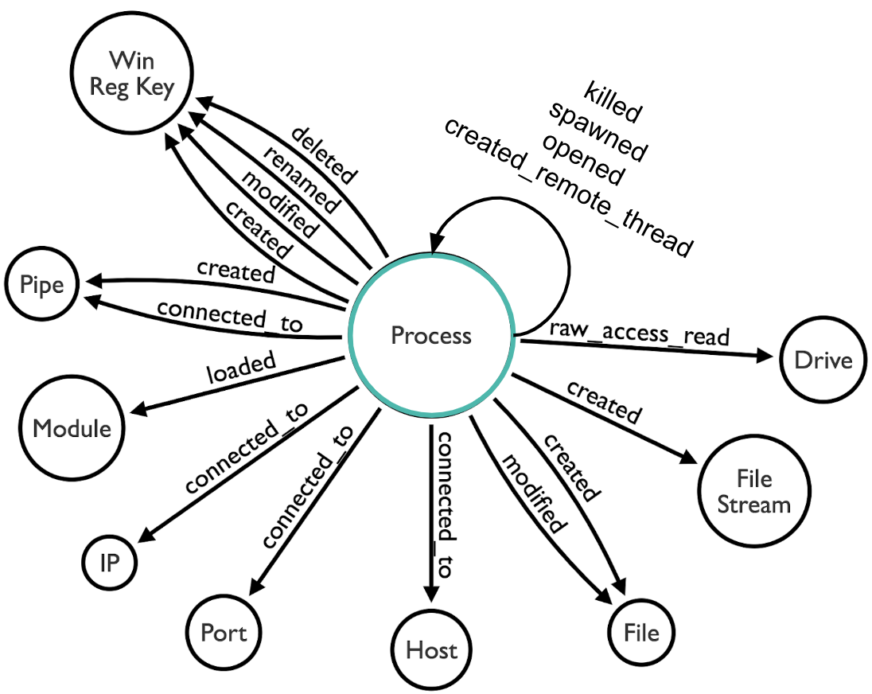
https://posts.specterops.io/real-time-sysmon-processing-via-ksql-and-helk-part-1-initial-integration-88c2b6eac839
Notes:
Image courtesy of Roberto Rordriguez who made it while working at Spectreops
I really love this image because It really helps us to think of Sysmon events as a cohesive “ecosystem” – many of the events are linked via common fields
Aim here is to show how to start taking advantage of these capabilities to gain visibility and increase your chances of finding the bad stuff in your networks

Slide 6
In Action - ImageLoads

Slide 7
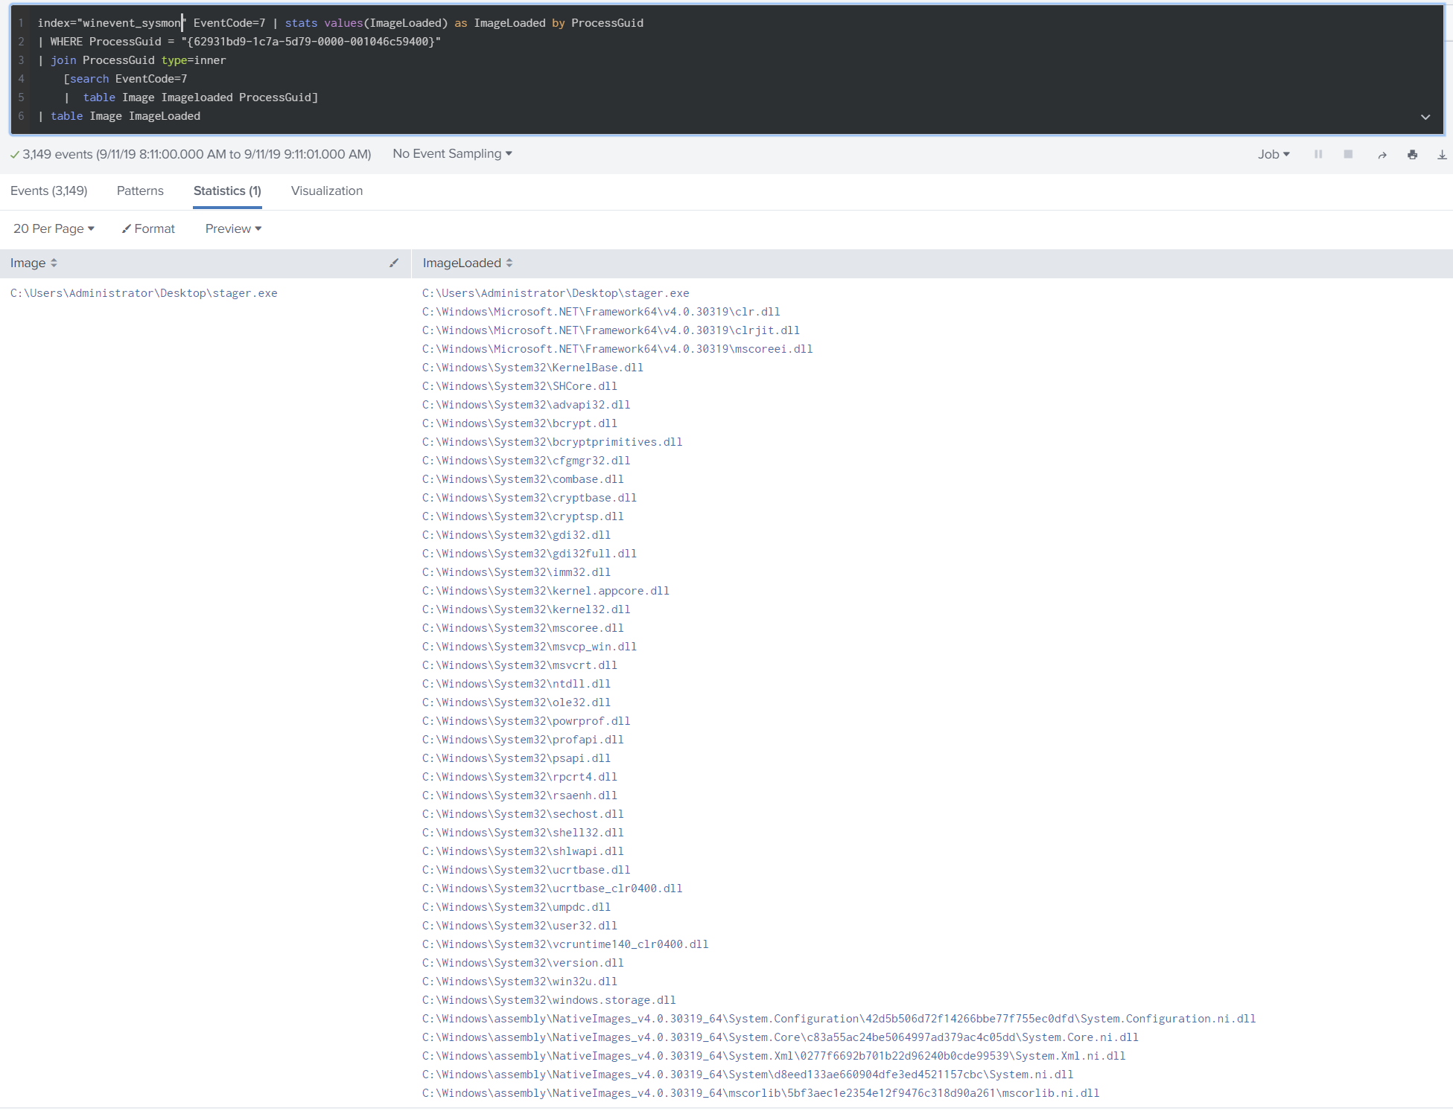

Slide 8
In Action – Process + Network = ❤

Slide 9
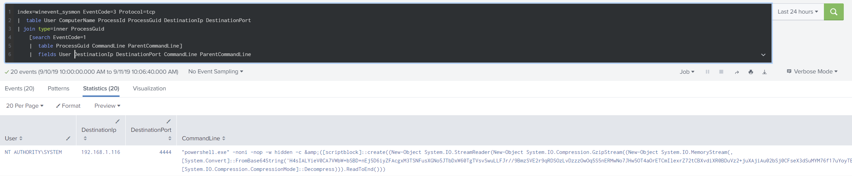

Slide 10
In Action- Show Me Everything

Slide 11
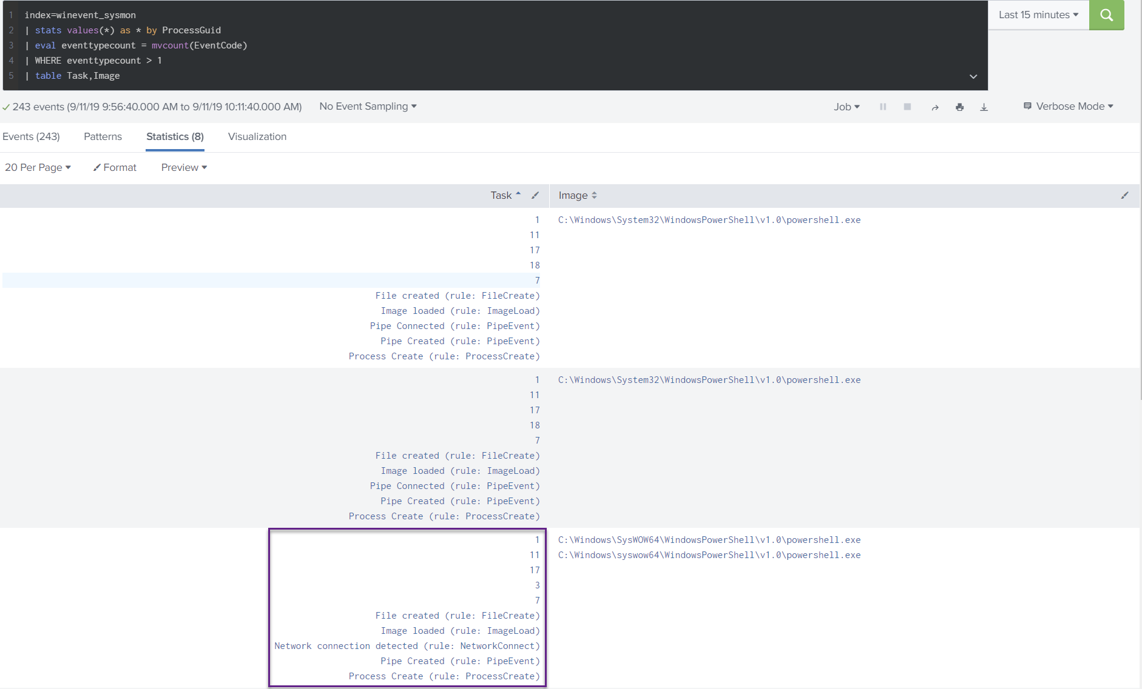

Slide 12
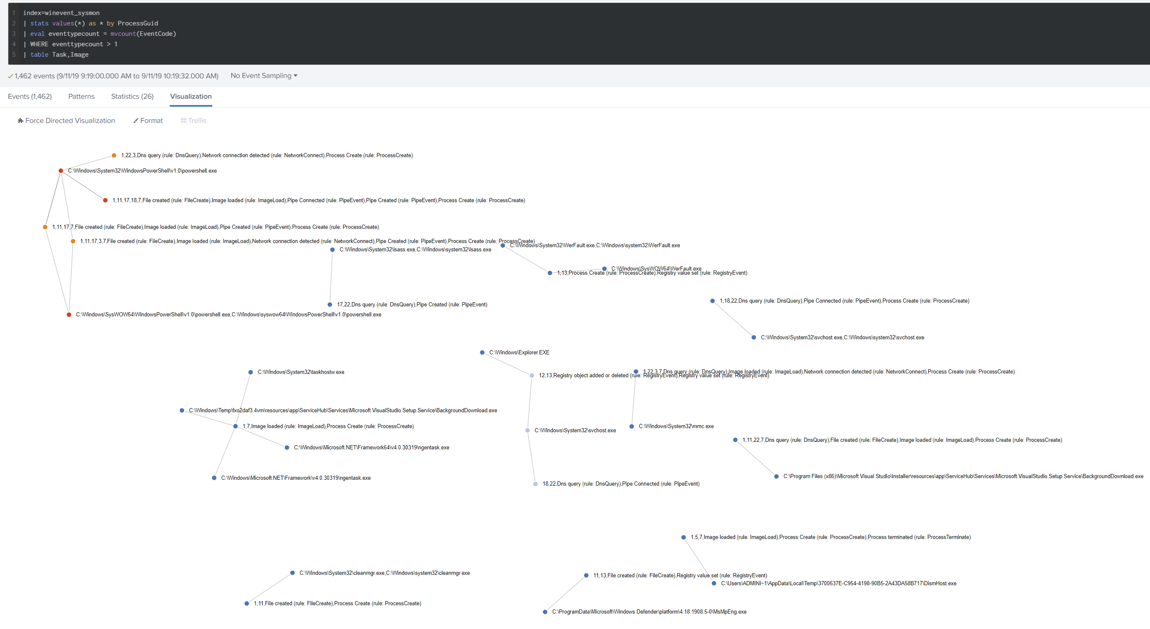

Slide 13
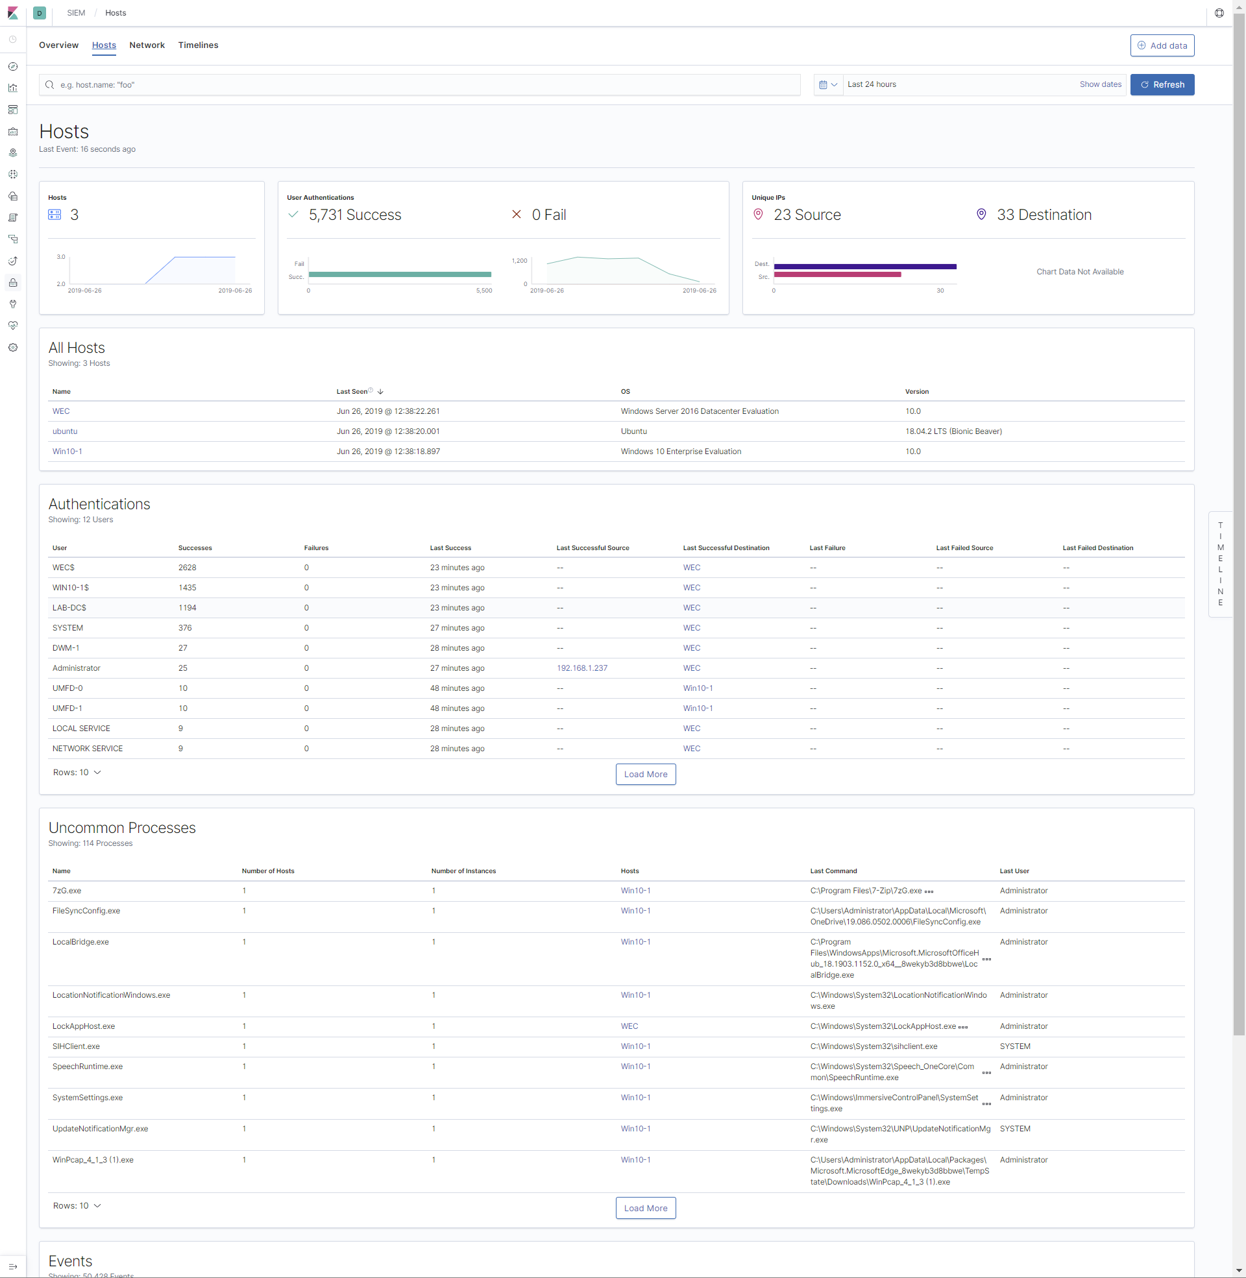
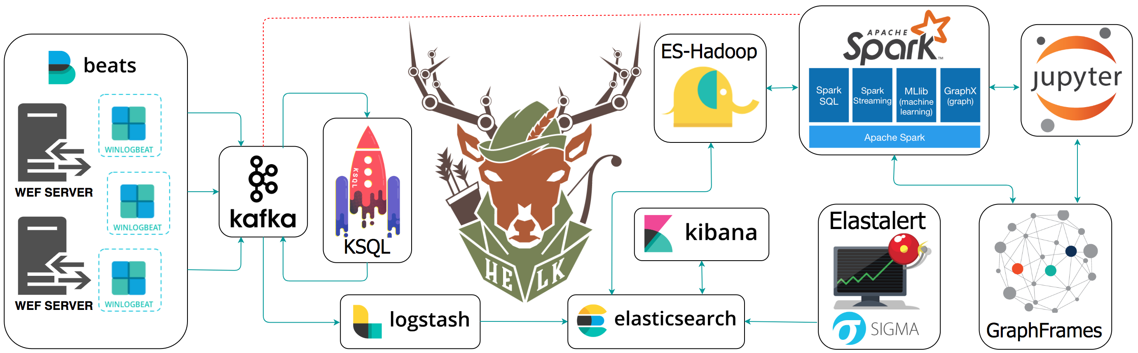
Not Just Splunk
https://github.com/Cyb3rWard0g/HELK- Try HELK
https://haveyousecured.blogspot.com/2019/06/elastic-siem-set-up.html - Setup Elastic SIEM
https://github.com/randomuserid/SpaceCake-Adama – Lots of ELK Searches

Slide 14
Sysmon
SIGMA
Moloch
BloodHound
KAPE
SilkETW

Slide 15
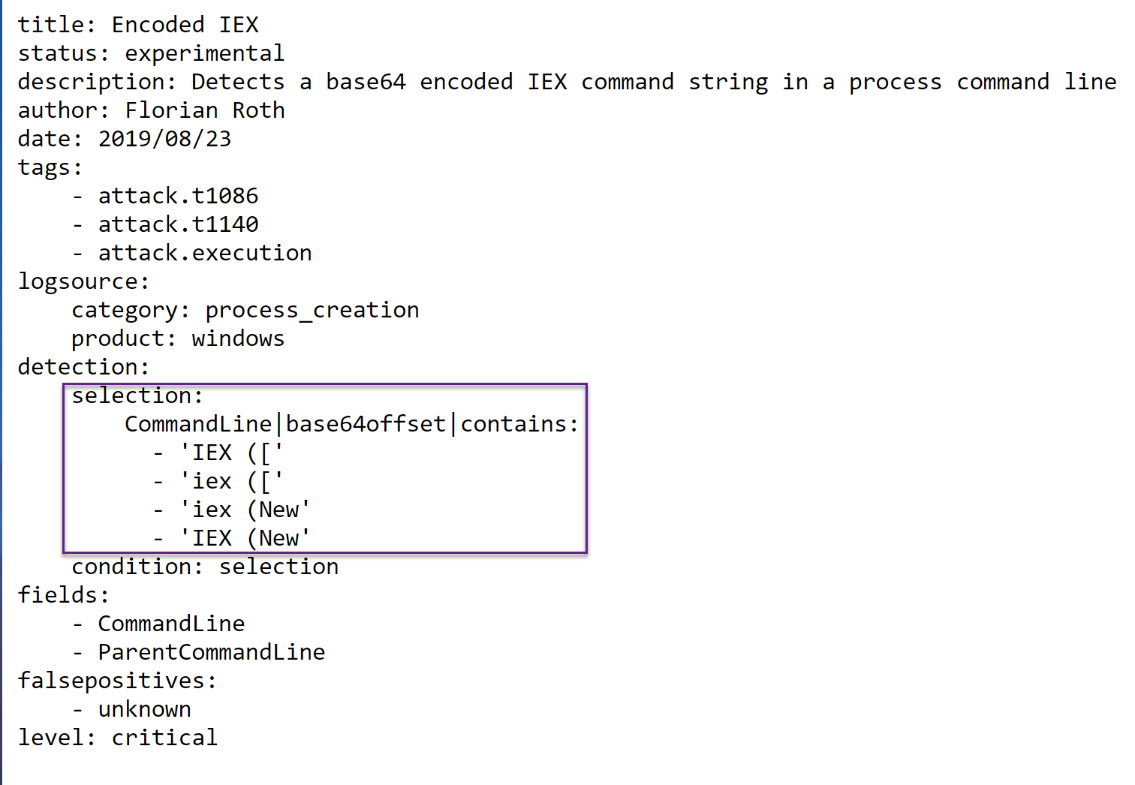

https://github.com/Neo23x0/sigma

Slide 16
Benefits
Easier to write SIEM alerts
Space for comments
Portable, convert queries from Elastic Splunk
Share queries

Slide 17
Sysmon
SIGMA
Moloch
BloodHound
KAPE
SilkETW

Slide 18
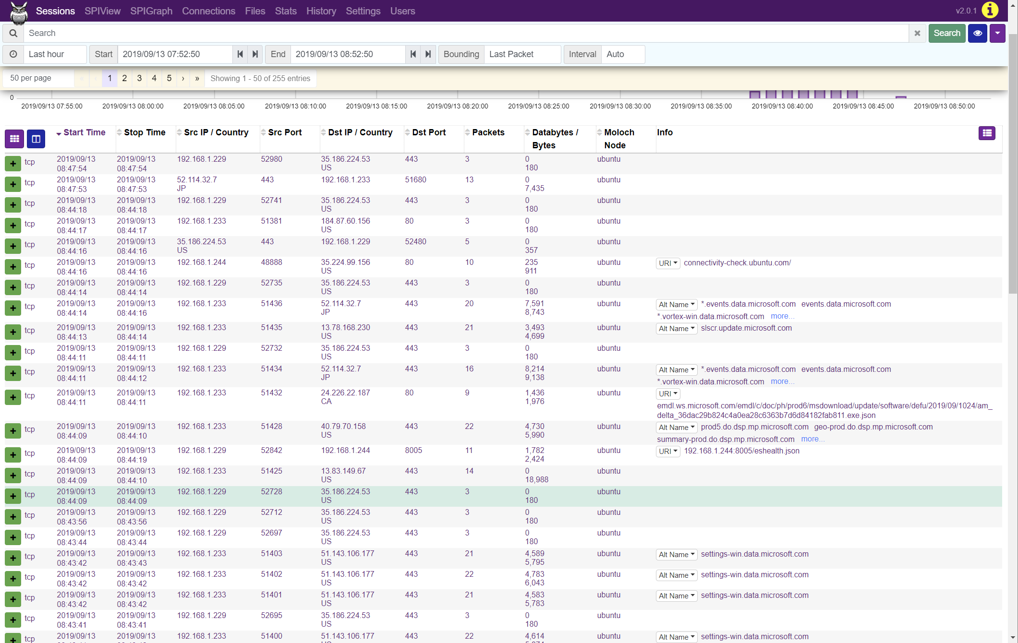

Slide 19
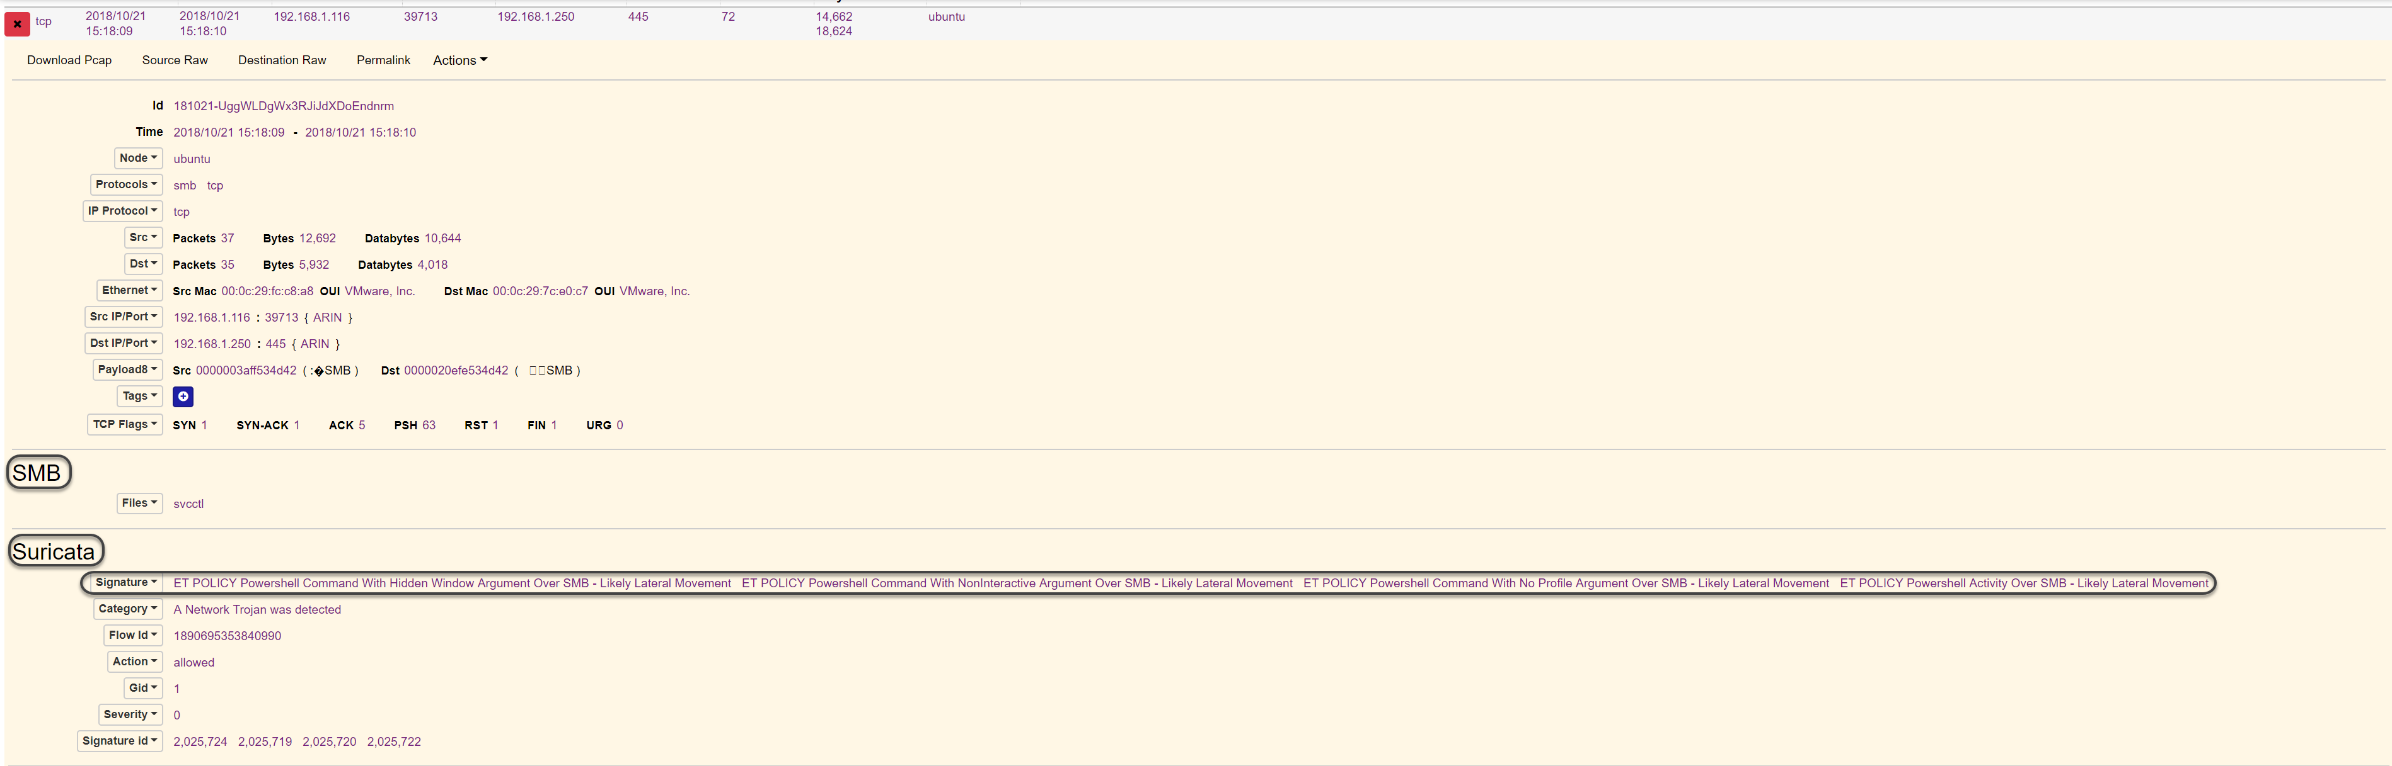

Slide 20
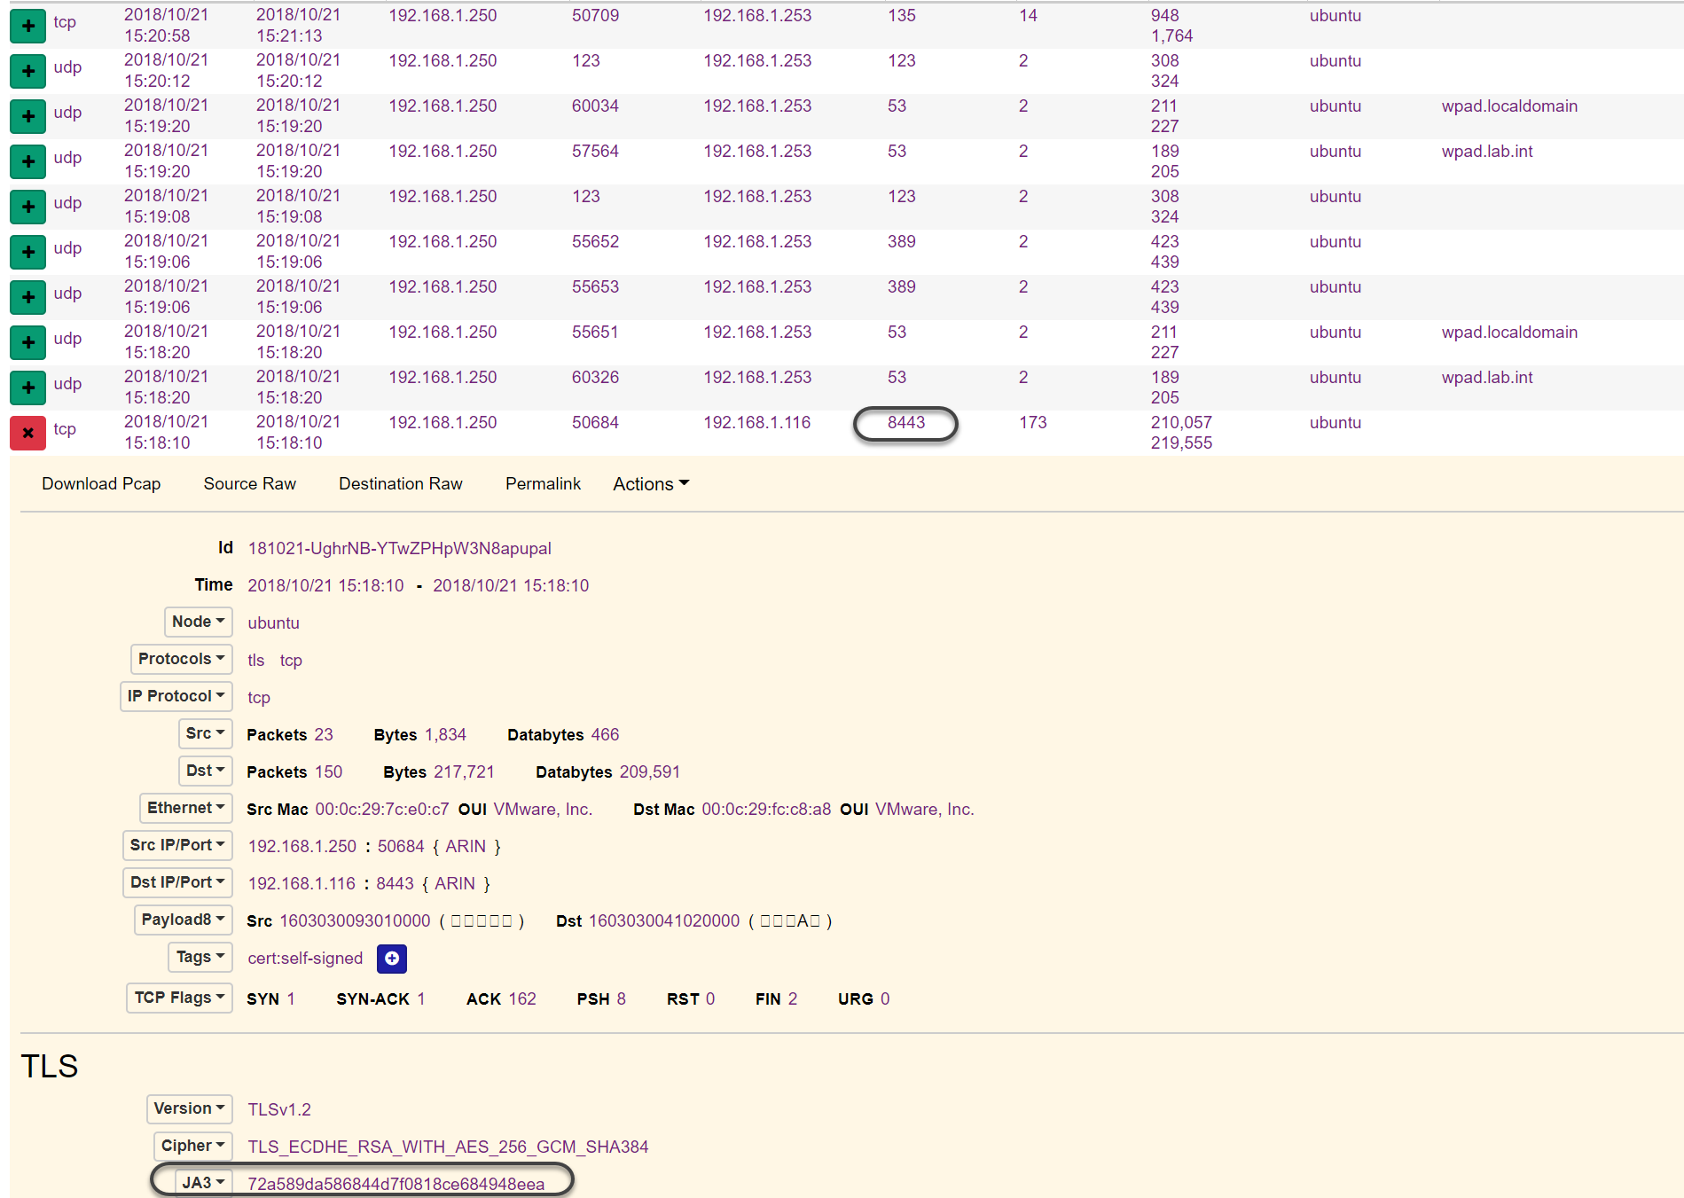
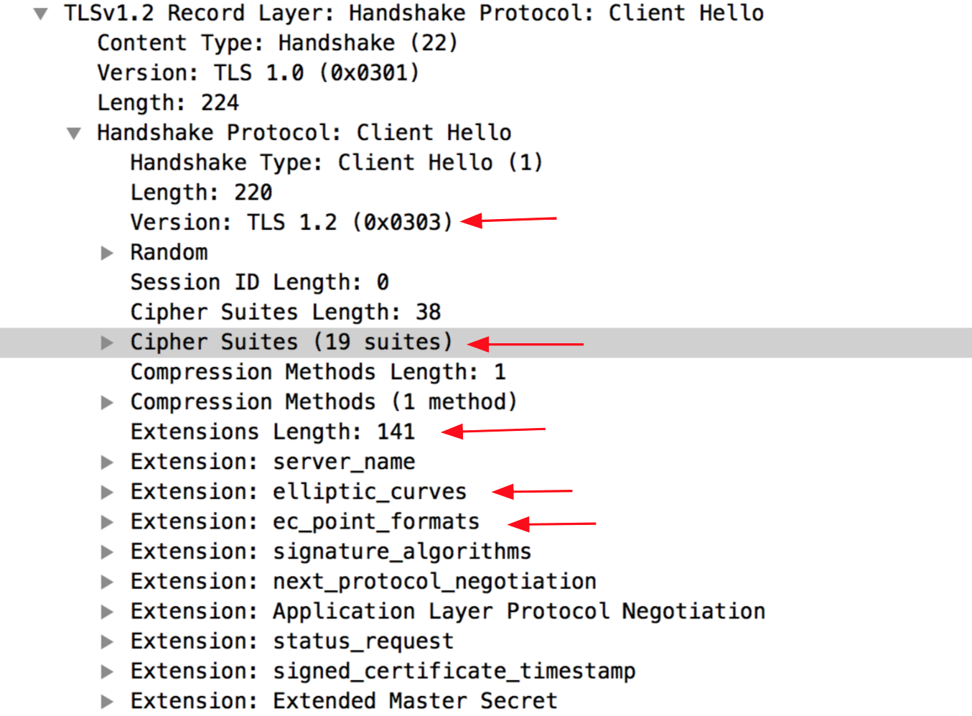
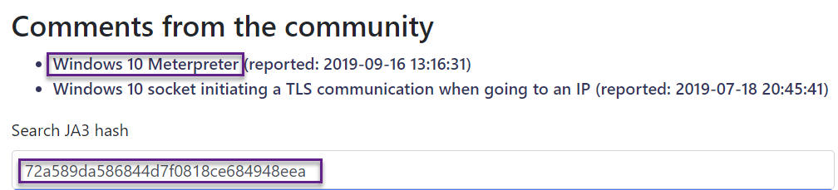
https://github.com/salesforce/ja3
https://engineering.salesforce.com/tls-fingerprinting-with-ja3-and-ja3s-247362855967
https://ja3er.com
https://github.com/LeeBrotherston/tls-fingerprinting

Slide 21
Additional Features
https://github.com/aol/moloch
https://molo.ch/
Data enrichment via WISE service
Host and username data from other systems
Vulnerability data from threat feeds
Translate JA3 to friendly names
YARA Support
Modular + Scalable
Great Slack Help
API
Click Actions – Check IPs in Virutstotal or GreyNoise
Hunts

Slide 22
Sysmon
SIGMA
Moloch
BloodHound
KAPE
SilkETW

Slide 23
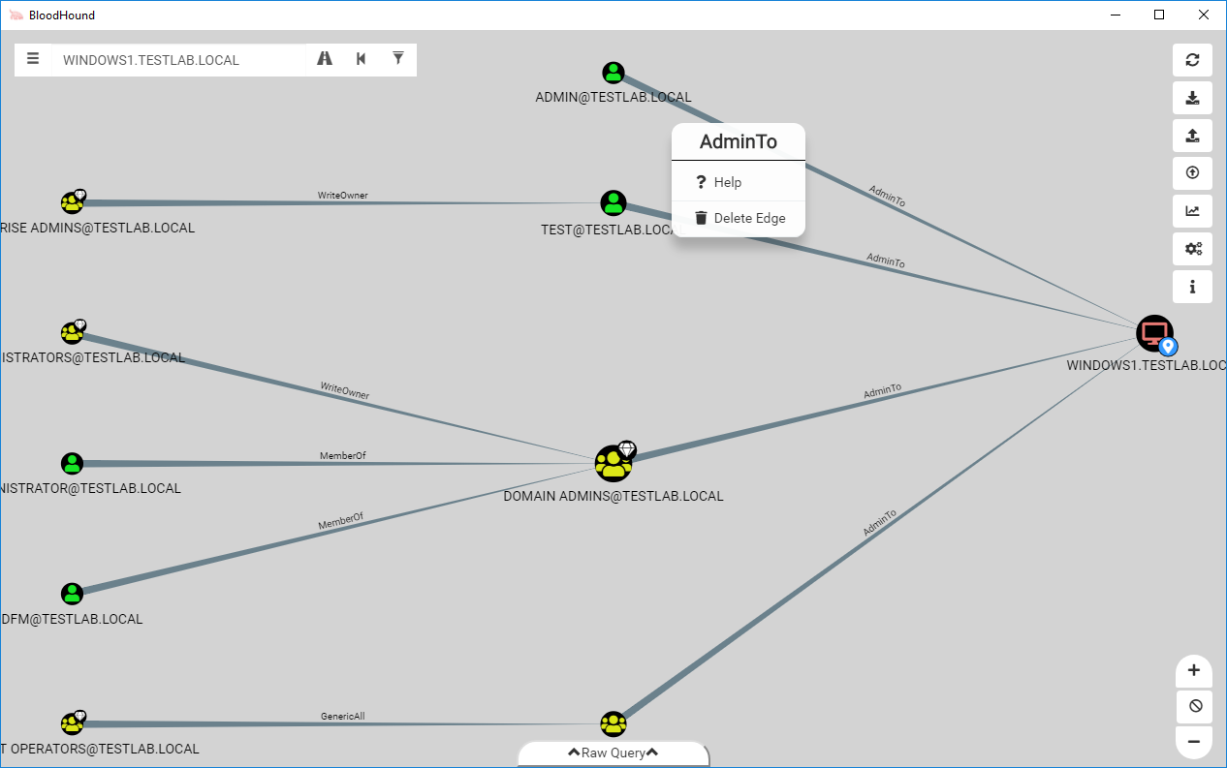
Image via https://posts.specterops.io/bloodhound-2-0-bc5117c45a99
https://github.com/BloodHoundAD/BloodHound → Get it
https://www.pentestpartners.com/security-blog/bloodhound-walkthrough-a-tool-for-many-tradecrafts/ →Set it up

Slide 24
What do I do with it?
Find paths to Domain Admins
Over Privileged Users
Kerberostable Users
All Your Active Directories secrets ☺
Feed the data back into your SIEM[?]
Whatever you do with BH, please donate:
mda.org/donate

Slide 25
Sysmon
SIGMA
Moloch
BloodHound
KAPE
SilkETW

Slide 26
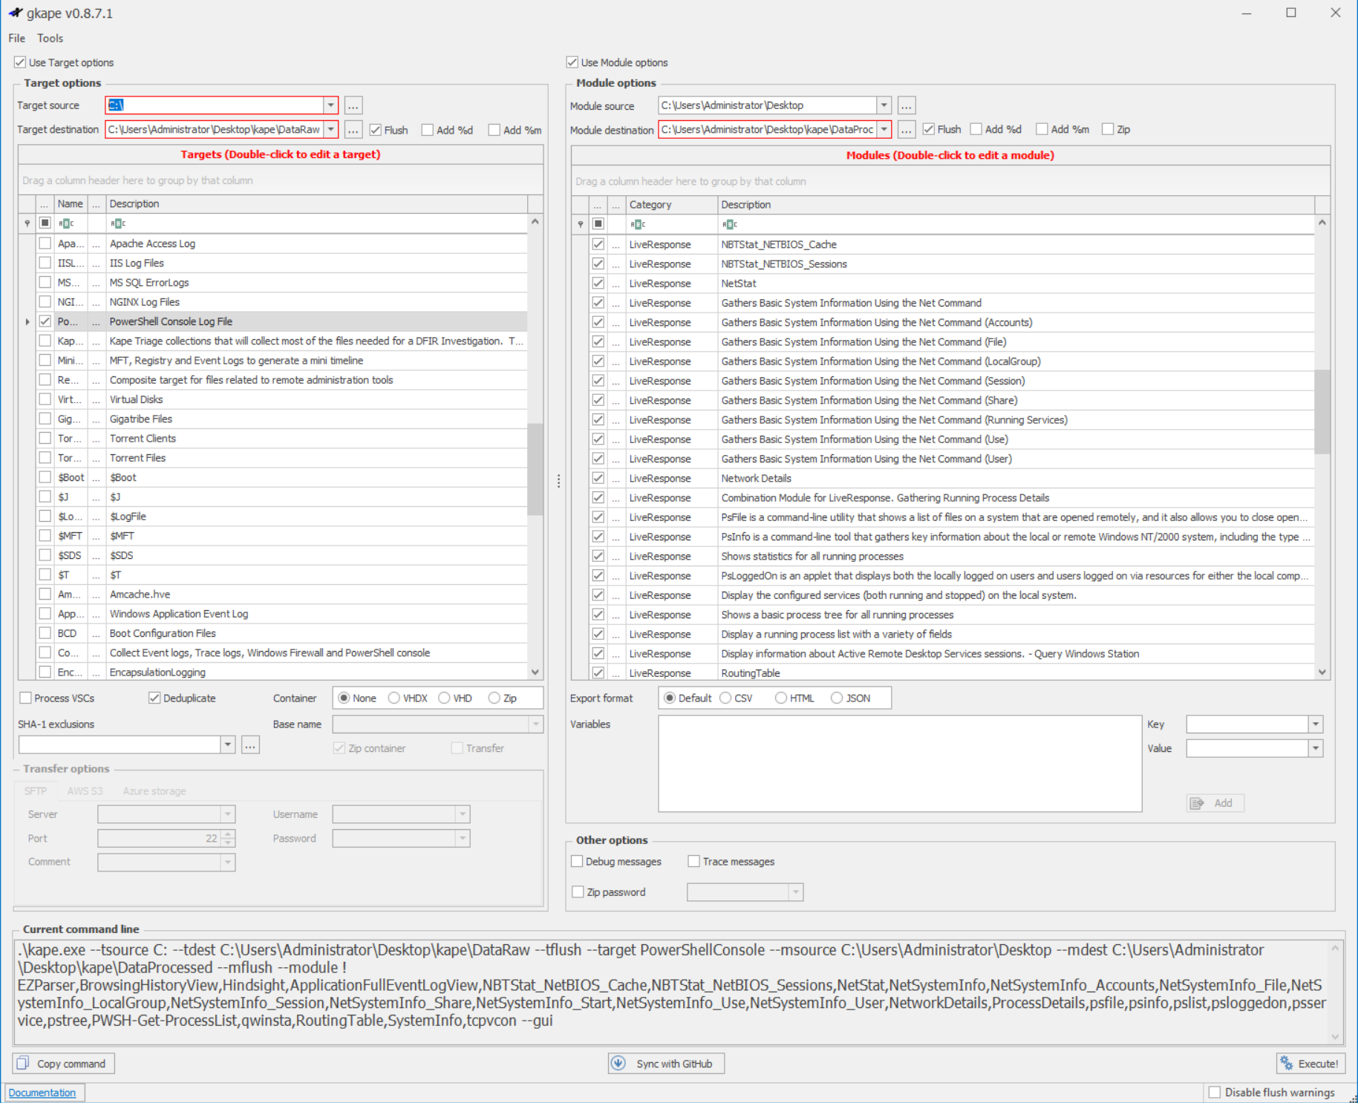

Slide 27
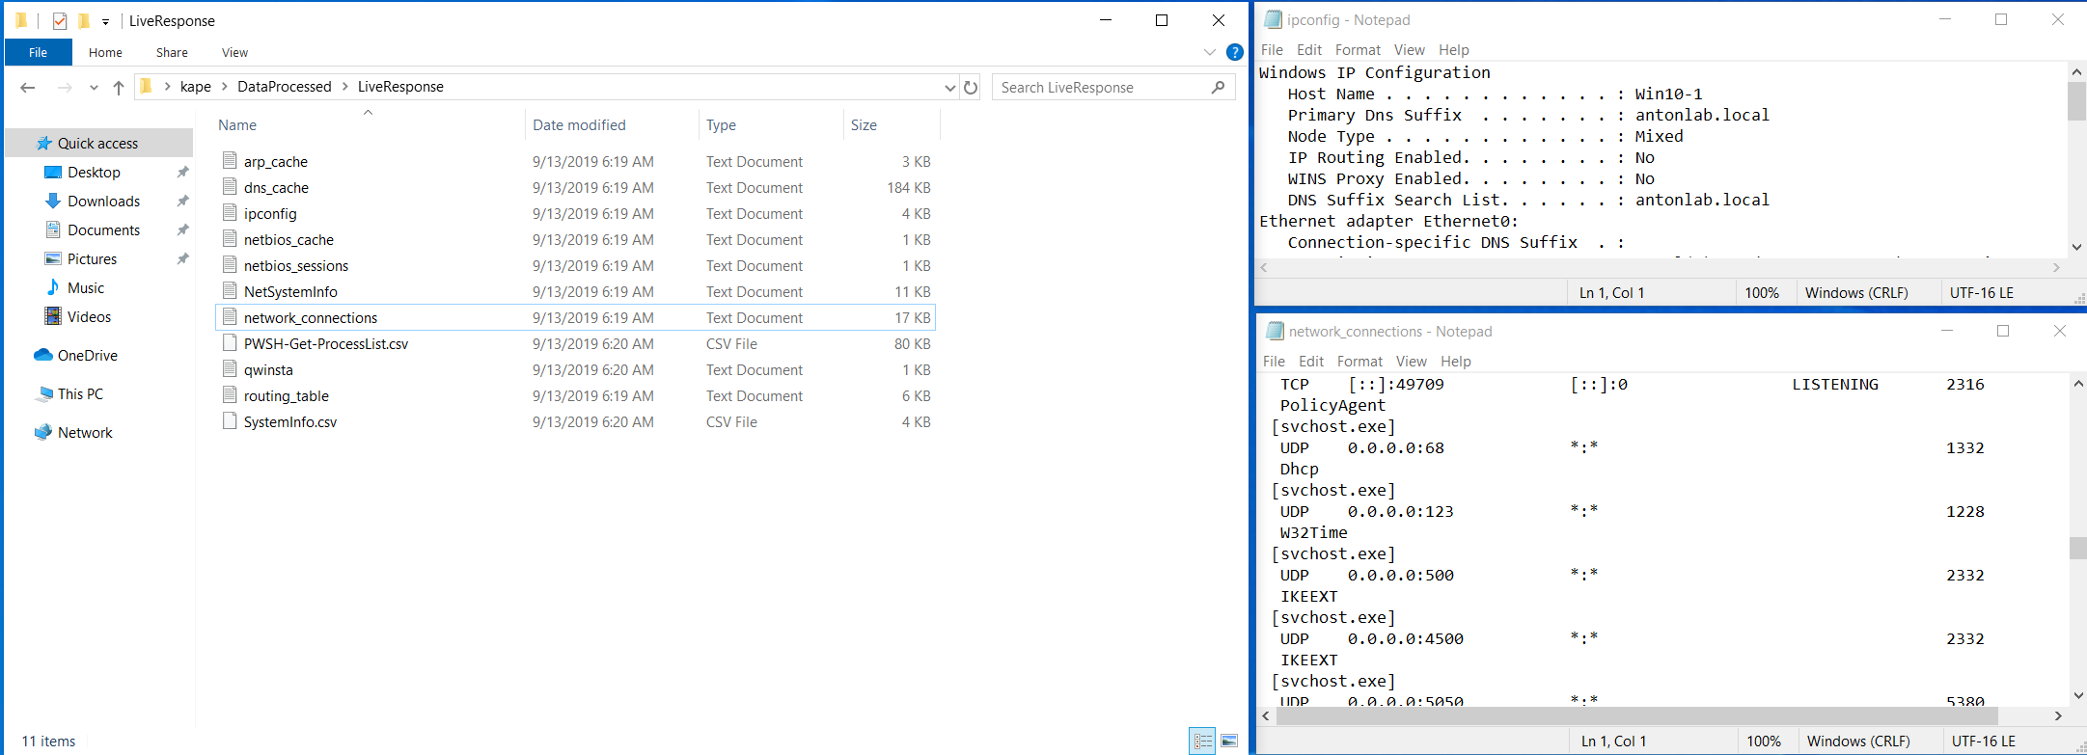
https://www.kroll.com/en/services/cyber-risk/investigate-and-respond/kroll-artifact-parser-extractor-kape

Slide 28
Sysmon
SIGMA
Moloch
BloodHound
KAPE
SilkETW

Slide 29
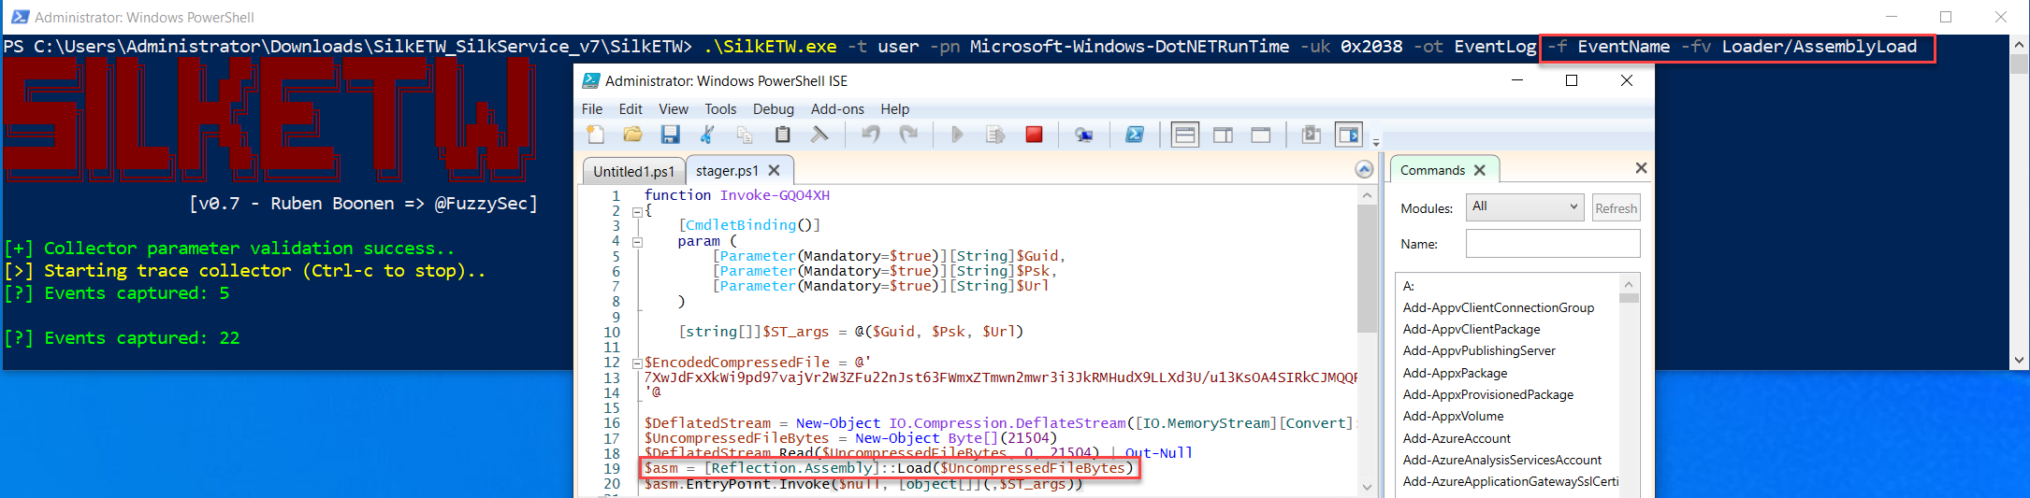
Makes ETW accessible and ingestible
Log to file or Event Log
Can also run as a service
Download → https://github.com/fireeye/SilkETW
Blog Post → https://www.fireeye.com/blog/threat-research/2019/03/silketw-because-free-telemetry-is-free.html

Slide 30
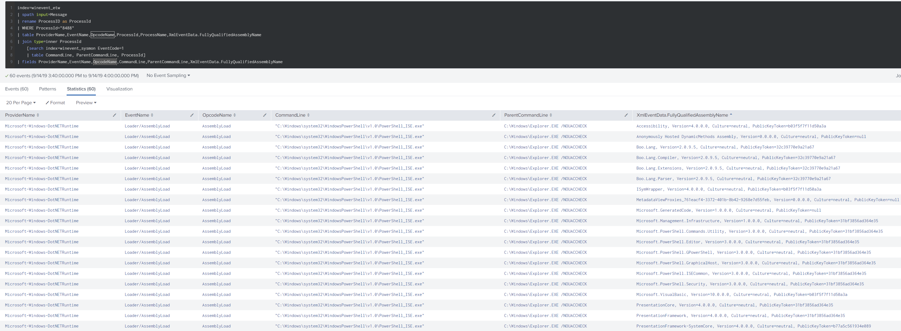

Slide 31
Takeaways
Excitement in the defense space
Lists → Graphs
Use your data
This is hard
Visibility rules

Slide 32

Thanks BSides! …Any Questions?

